Slide 1
Obtaining SPICE Products Available from the NAIF and Horizons Servers Emphasis on Kernels
April 2023

Slide 2
Overview
Many SPICE products are available from the NAIF server
These are mostly SPICE products produced at JPL
Access is available using the https protocol
See the next page for URLs
SPICE products made by other organizations are controlled by those organizations
Some may be available from the NAIF server
Some may be available at other public servers, or on restricted servers, or not at all
The International Planetary Data Alliance (IPDA) is working towards making large amounts of archived planetary data, including SPICE, universally available through “all” agency archives
Unfortunately there is no simple rule set to describe what may be found where
As a general rule, NAIF has no cognizance of these products

Slide 3
NAIF Server URLs
NAIF home page
https://naif.jpl.nasa.gov
Here you may access all official SPICE products produced by NAIF
- kernels (generic, mission operations, and PDS archived ancillary data)
- software (Toolkits and individual utility programs)
- documents
tutorials
programming lessons
problem solving tips
rules about using SPICE
links to useful resources
access to the WebGeocalc tool
access to the Cosmographia visualization program
SPICE announcements (by NAIF)
https://naif.jpl.nasa.gov/mailman/listinfo/spice_announce
For use by NAIF staff in making assorted announcements.
SPICE discussion (by anyone)
https://naif.jpl.nasa.gov/mailman/listinfo/spice_discussion
For use by SPICE users who wish to communicate with other SPICE users
(Don’t use this if you have questions for NAIF staff)

Slide 4
Getting SPICE Kernels
The remaining charts discuss where to find the various categories of SPICE kernel files
Operational flight project kernels
For active flight projects, mostly those at JPL
PDS archived kernels
Those that have been delivered to and reviewed and accepted by the NAIF Node of NASA’s Planetary Data System as part of a formal archive compliant with PDS3 or PDS4 standards
These are the most easily used, due to the existence of furnsh kernels (meta-kernels)!
These cover from launch to typically 6-to-9 months behind current time
Generic kernels
Not tied to any one specific mission
Used by many flight projects and other endeavors
Some of these are also available in the other two categories
How to generate SPKs for comets and asteroids

Slide 5
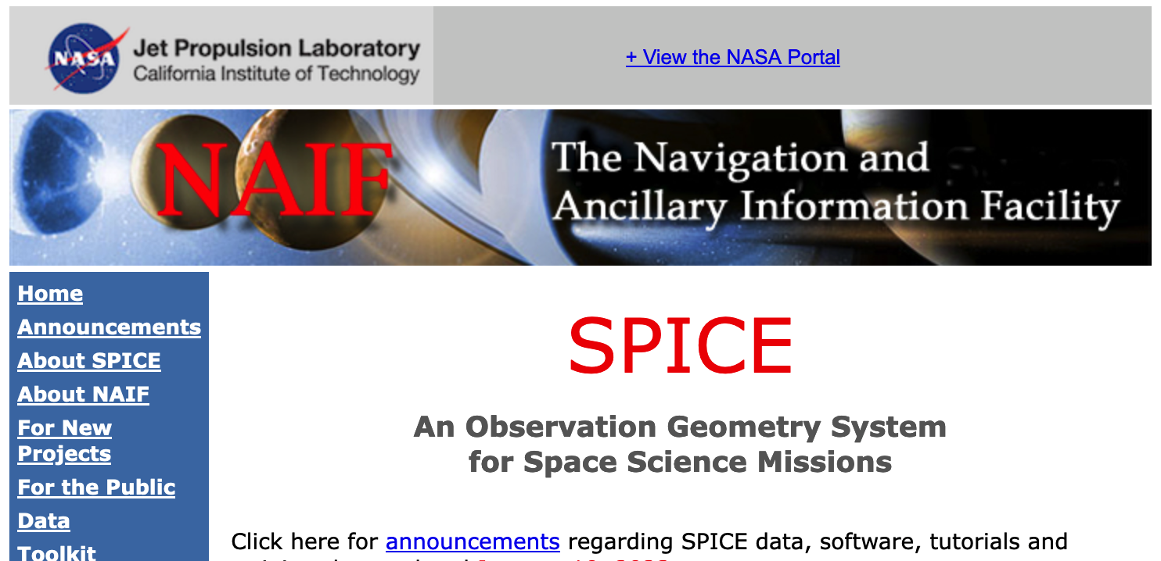
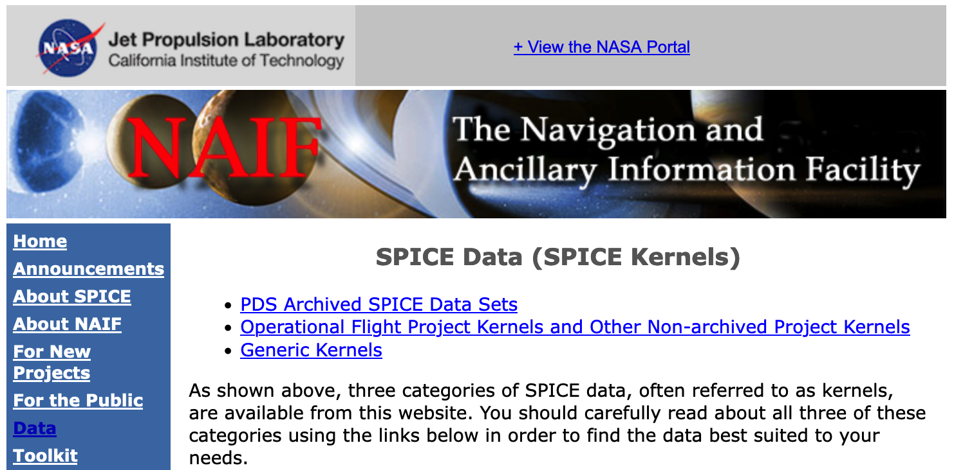
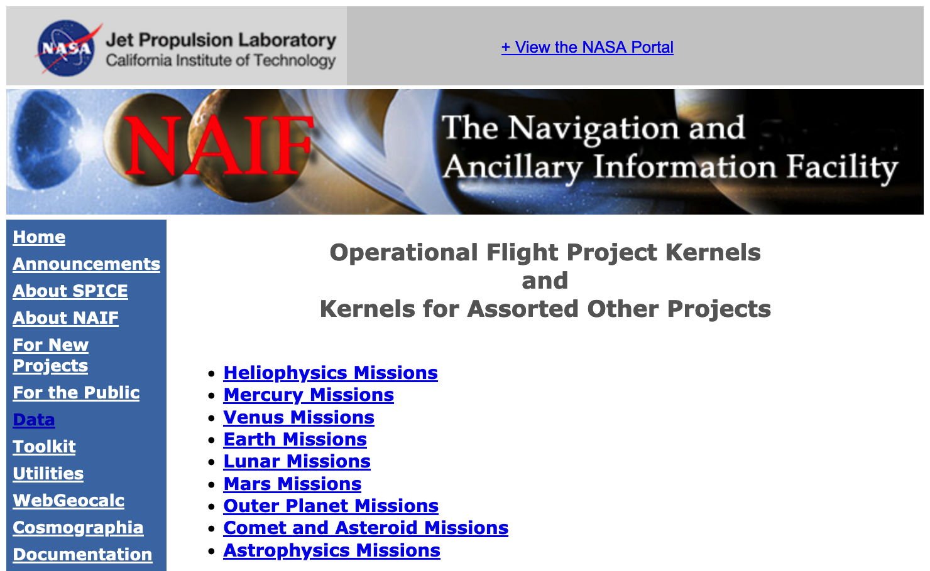
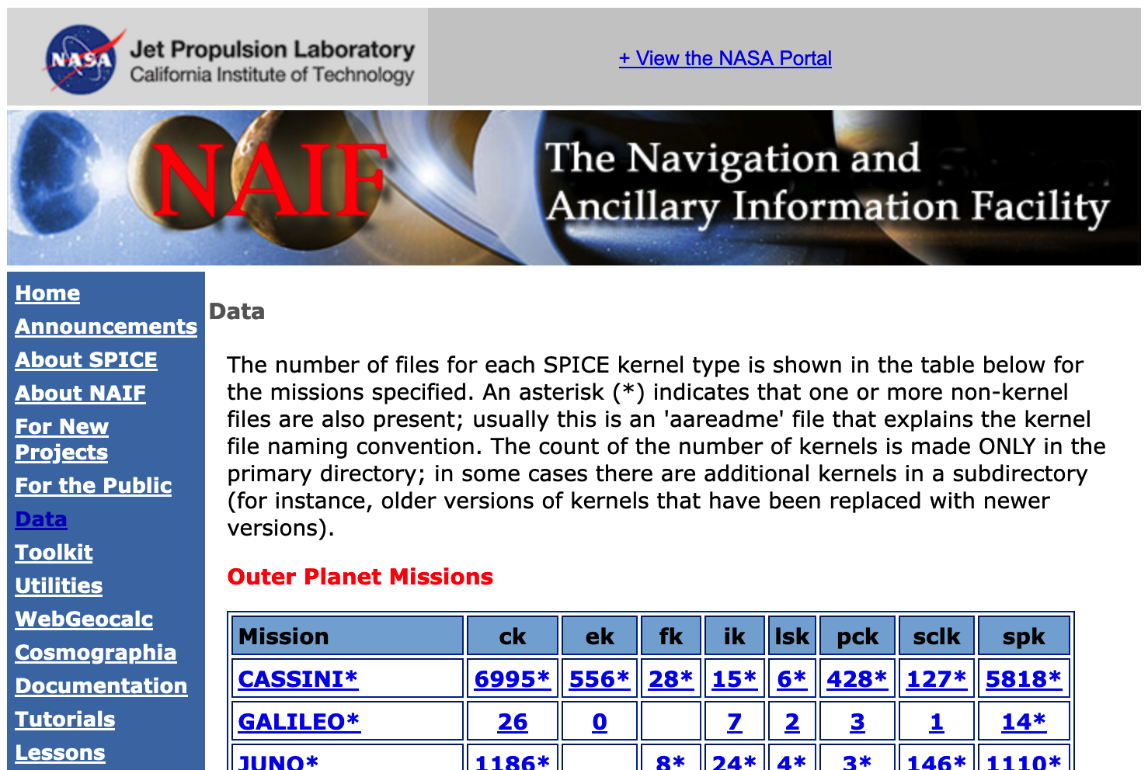
Getting Operational Project Kernels - 1
1 – Select Data
2 – Select OPS Data
3 - Select the mission class of interest
4 – Select mission or kernel type
4a - Select the project name to get access to the kernels folder for that project with sub-folders for all kernel types (see next page)
-or-
4b - Select the kernel type to get access to all kernels of that type for that project. The number tells how many kernels of that type are available. (see next page)

Slide 6
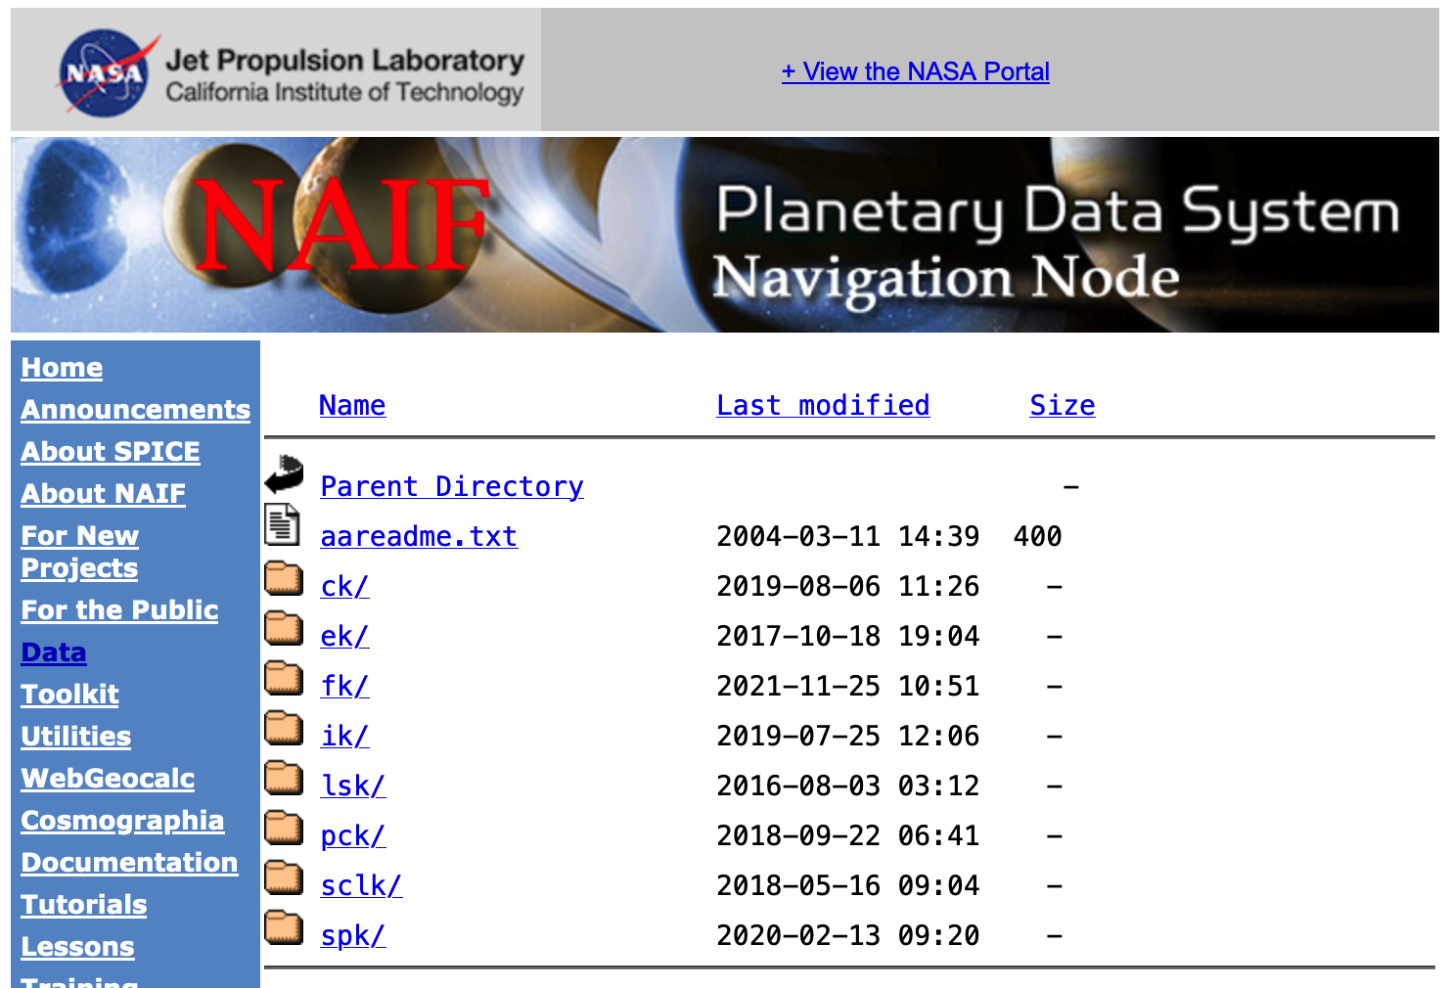
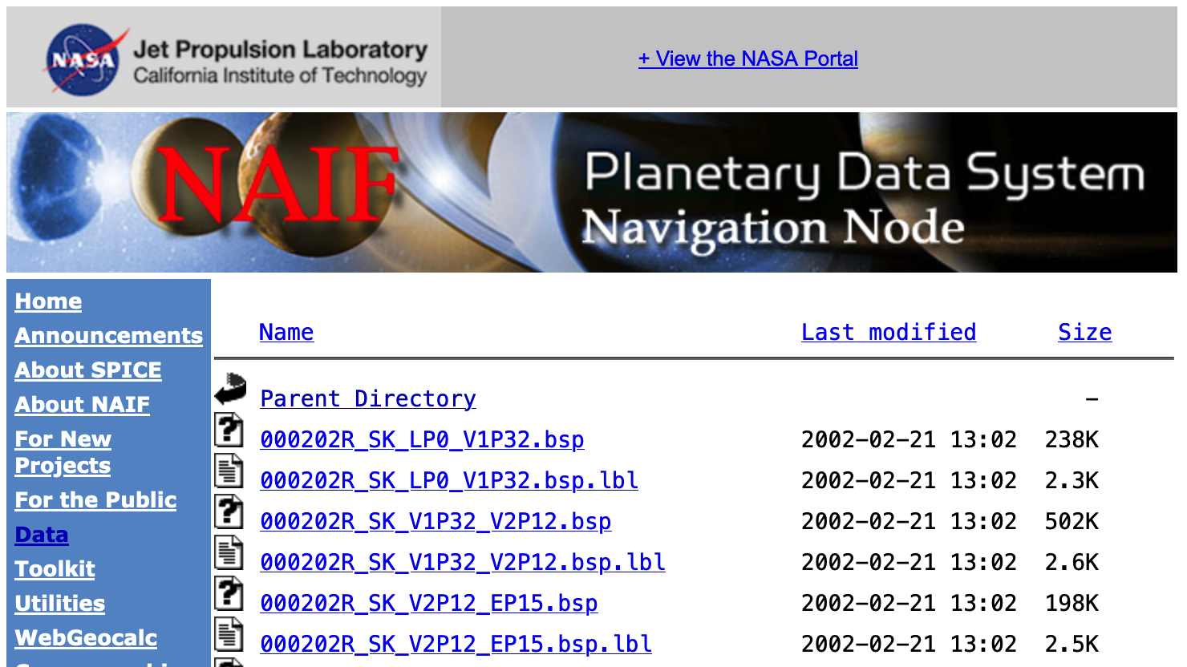
Getting Operational Project Kernels - 2
Access to all kernels for the named project
Access to kernels of the selected type for the named project
SPK file (binary)
Detached file label
(plain text)
. . .
Then change to the folder containing
the kind of kernels of interest to you,
such as SPK.
Description of file naming scheme

Slide 7
Getting PDS Archived Kernels - 1
The best method for obtaining PDS archived kernels is directly from the NAIF server.
Complete SPICE data sets exist on the NAIF server fully expanded–not bundled in a Zip or tar file
Unless you have reason to do otherwise, download the entire archival data set using the "Archive Link"
That way you’ll get all the latest data, the associated “furnsh kernels”, and the best documentation.
If the data set is large and you need only a portion of it based on start/stop time, use the “subsetter” link to obtain the smaller amount of data needed.
Pictorial examples are shown on the next few pages.

Slide 8
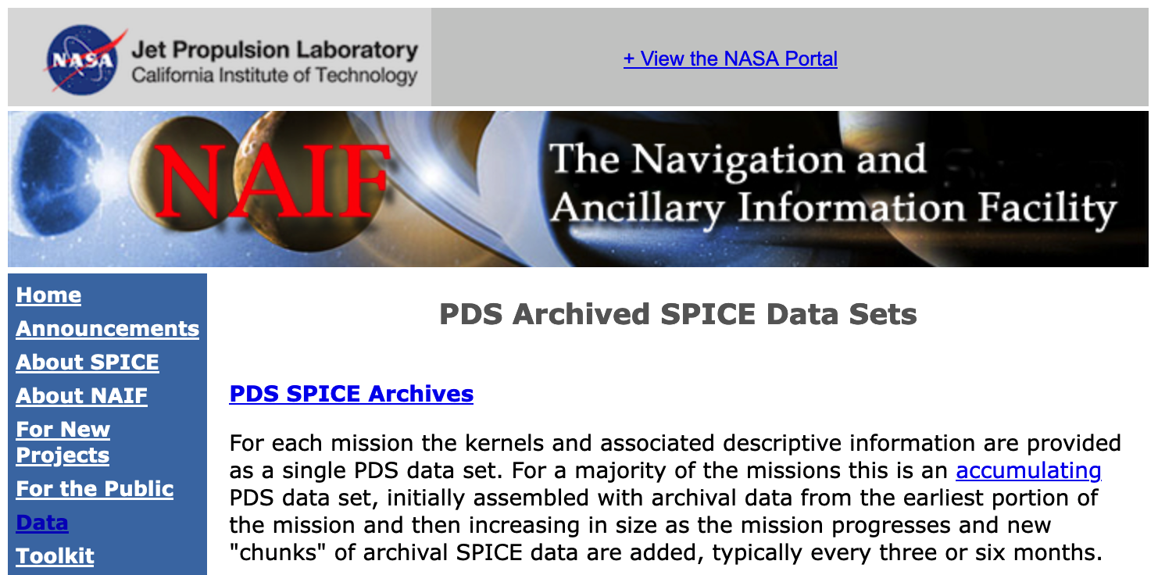
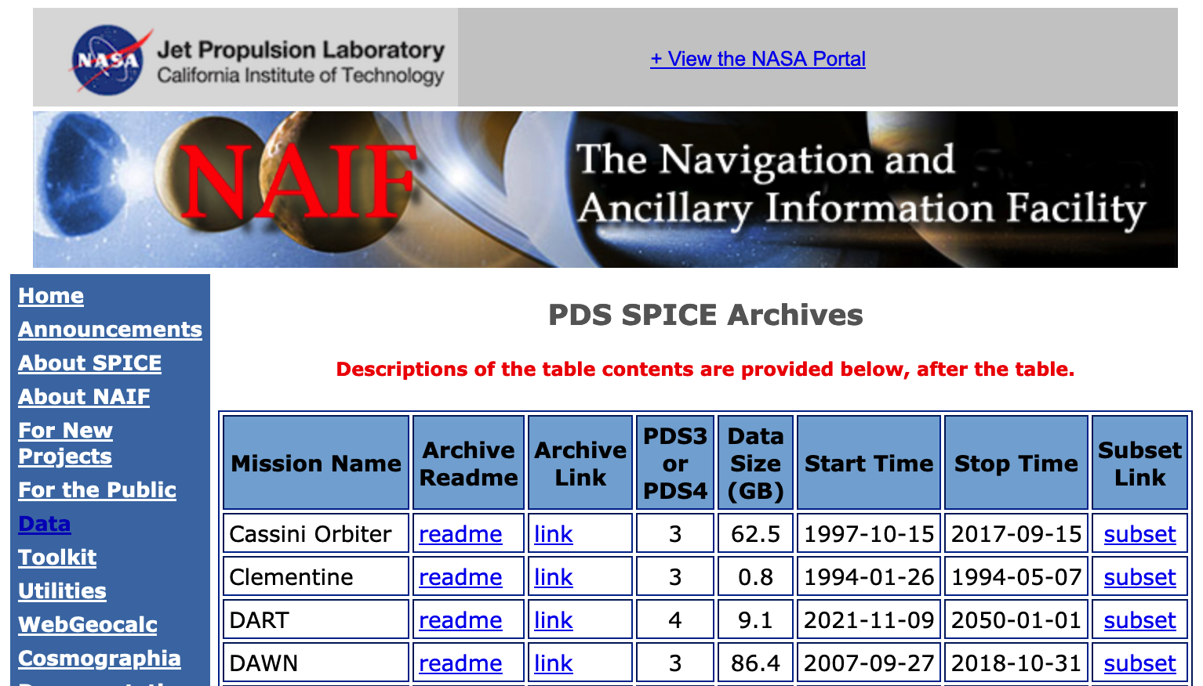
Getting PDS Archived Kernels - 2
1 – Select Data
2 – Select PDS Data
3 - Select PDS archives
4 – Copy or select archive link
4a – Copy link to get the whole archive using “wget”
https://naif.jpl.nasa.gov/pub/naif/pds/
data/co-s_j_e_v-spice-6-v1.0/cosp_1000
-or-
4b - Select archive link to browse archive directory tree and access individual kernels, meta-kernels, and archive documentation (see next pages)

Slide 9
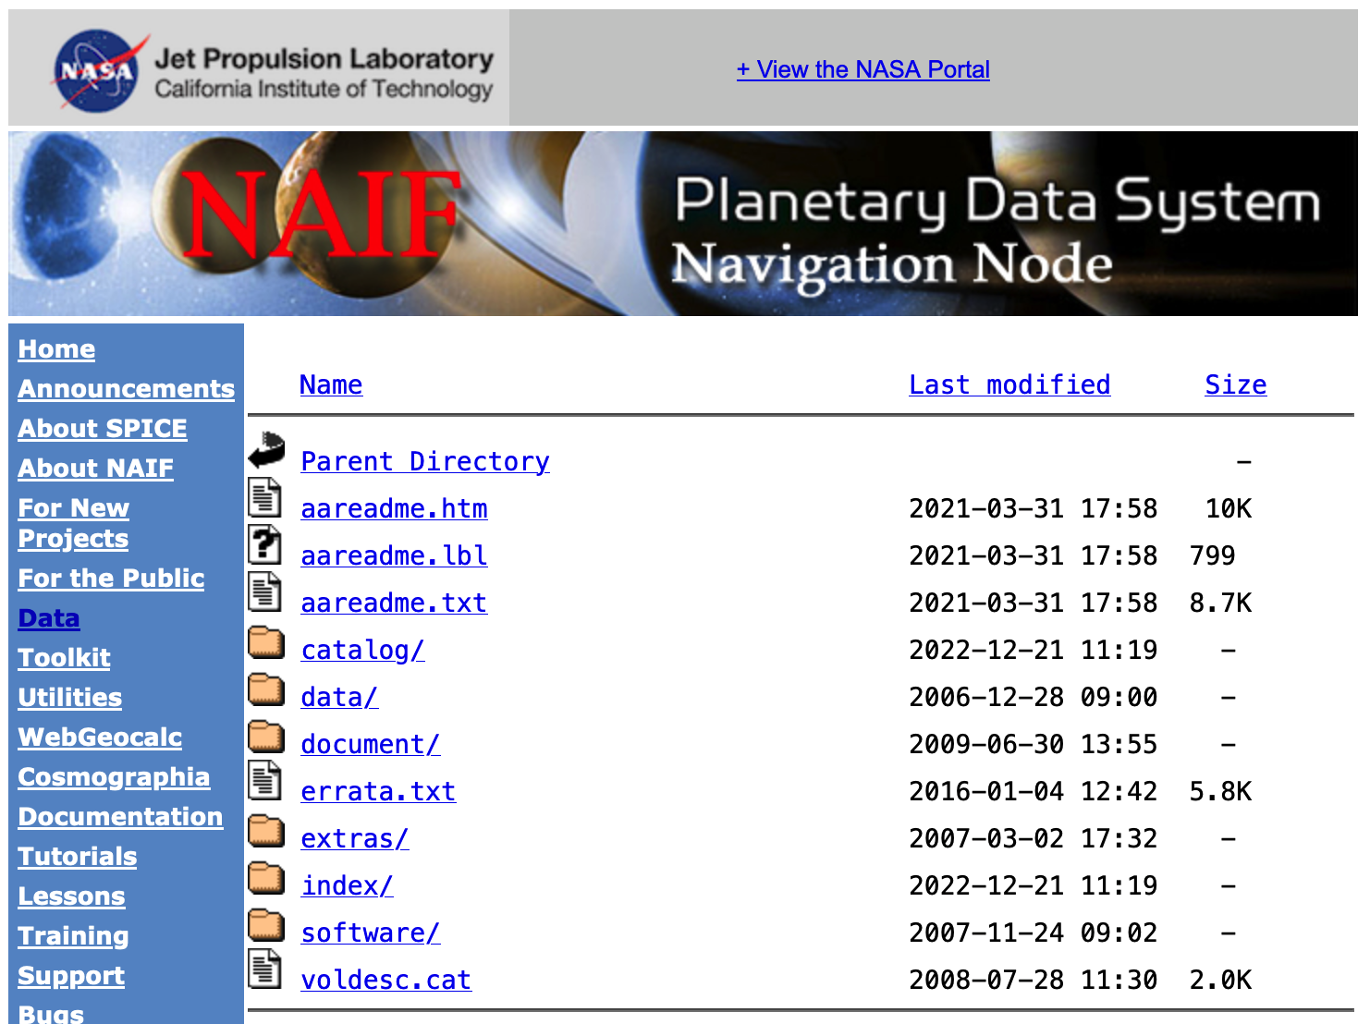
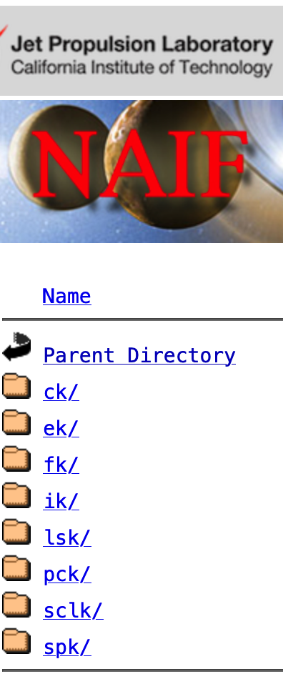
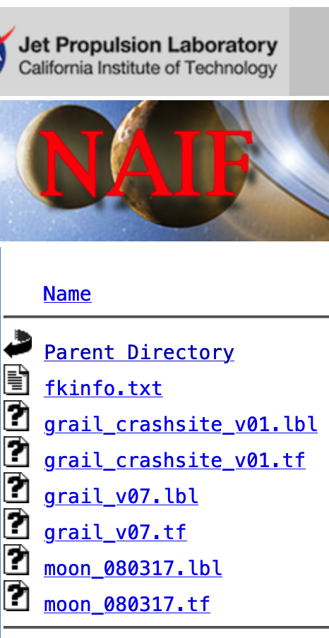
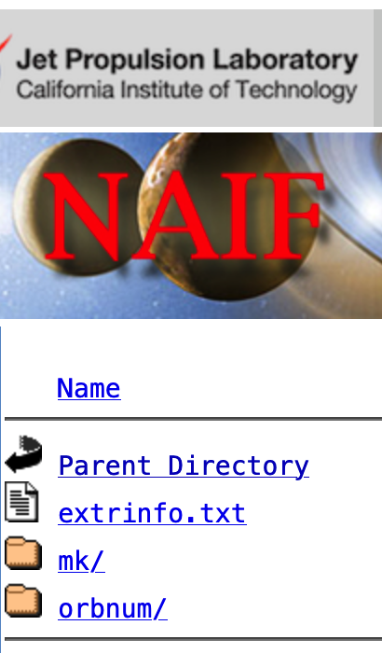
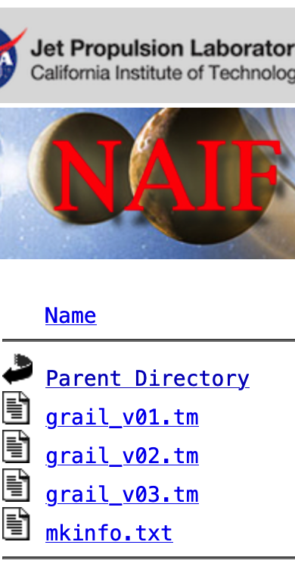
Getting Archived Kernels – PDS3
Top level directory on a PDS3 SPICE archive
Select “aareadme.htm” to access PDS3 archive description document
Select a kernel-type folder to access kernels
Select “data” to access kernel-type folders
Select “extras” to access “mk” folder
Select “mk” to access meta-kernels

Slide 10
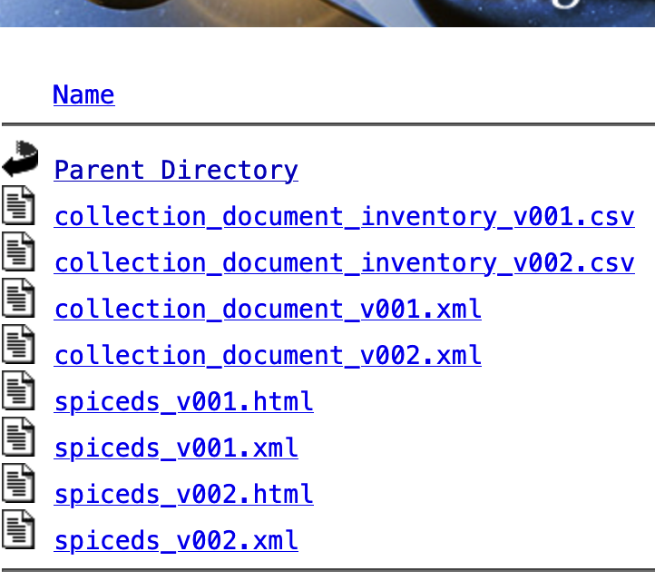
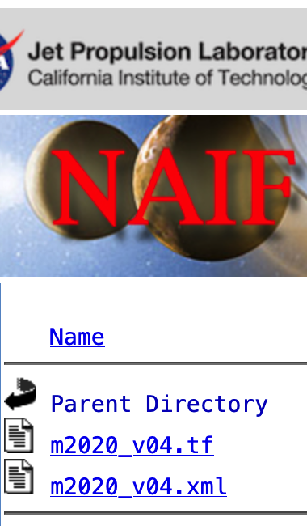
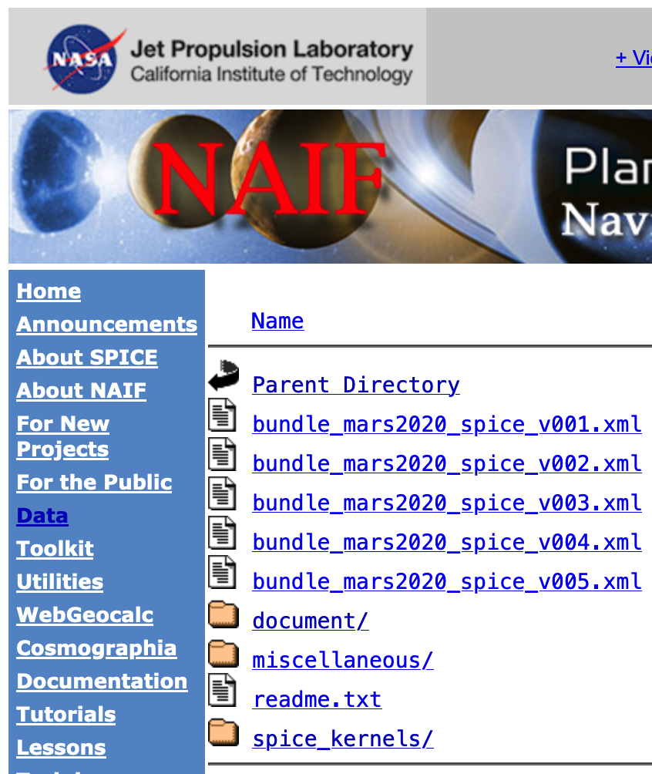
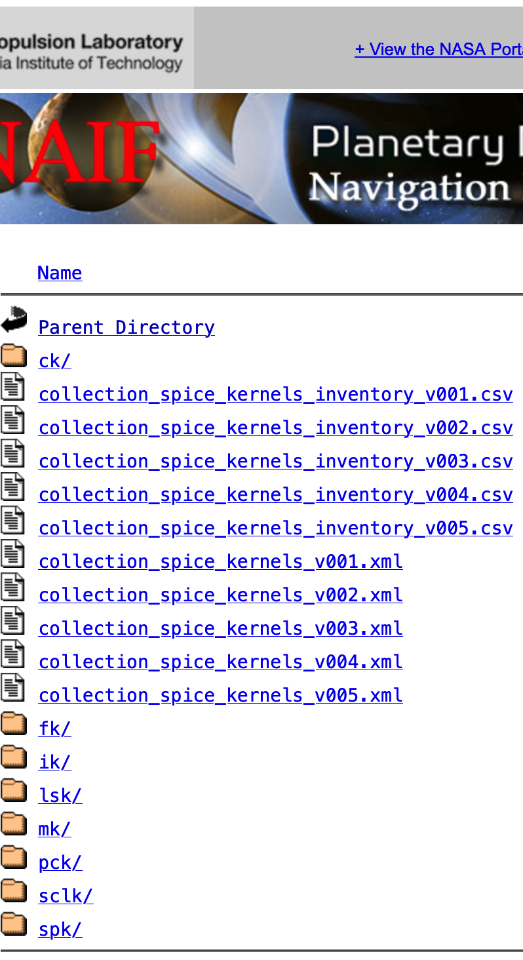
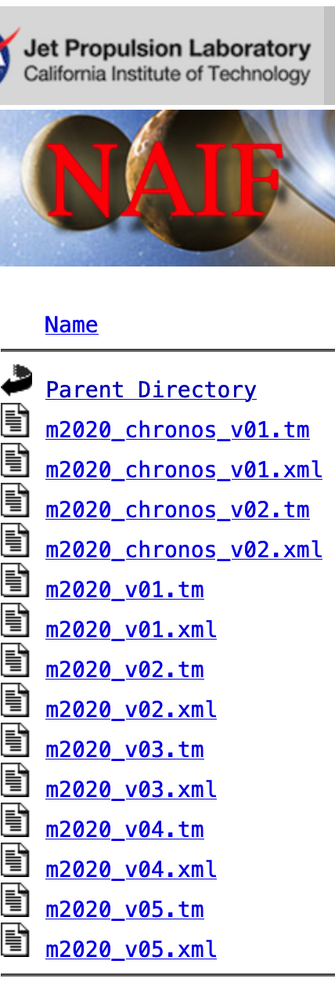
Getting Archived Kernels – PDS4
Top level directory on a PDS4 SPICE archive
Select “document” to access PDS4 archive description document
Select a kernel-type folder to access kernels
Select “spice_kernels” to access kernel-type and “mk” folders
Select “mk” to access meta-kernels

Slide 11
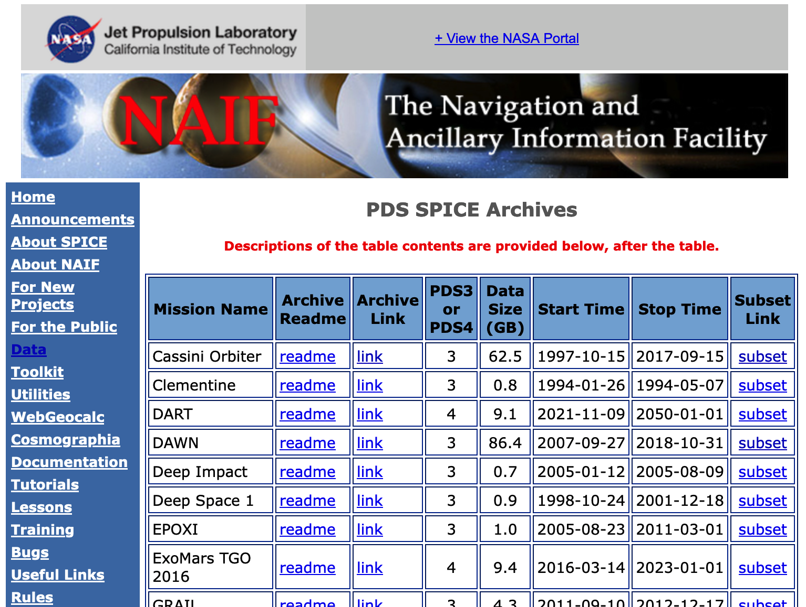
Obtaining Archived Kernels - Subsetter
Use the Subsetter tool to obtain a part of an archive covering a period of interest.
Specify subset start and stop times in the form
Subsetter will:
select just the kernels that fall within or overlap the specified time bounds
construct a new meta-kernels containing the names of this subset of kernels (thus making it easy to load the subset into your program)
create a custom wget script that can be used to download these files to a user computer
Run the script to download kernels and adjust path in MK to use them
Select “subset” to obtain a subset of an archive
Type in subset start and stop times and click “Subset”

Slide 12
Downloading Archived Kernels – wget
Use GNU’s wget or a similar utility to download the complete SPICE data set
Example using wget on the Deep Impact mission:
Open a terminal window
wget -m -nH --cut-dirs=5 -nv (insert the URL of the "Archive Link" for the SPICE data set here). For example:
wget -m -nH --cut-dirs=5 -nv http://naif.jpl.nasa.gov/pub/naif/pds/data/di-c-spice-6-v1.0/disp_1000/

Slide 13
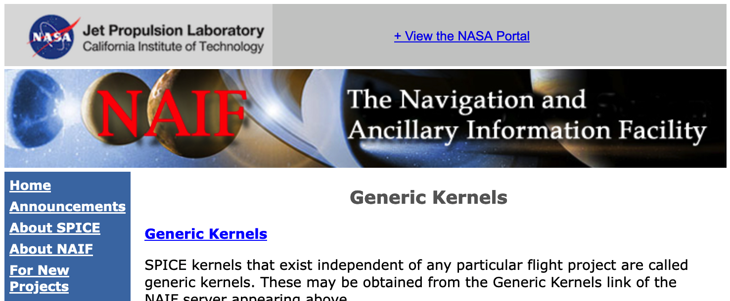
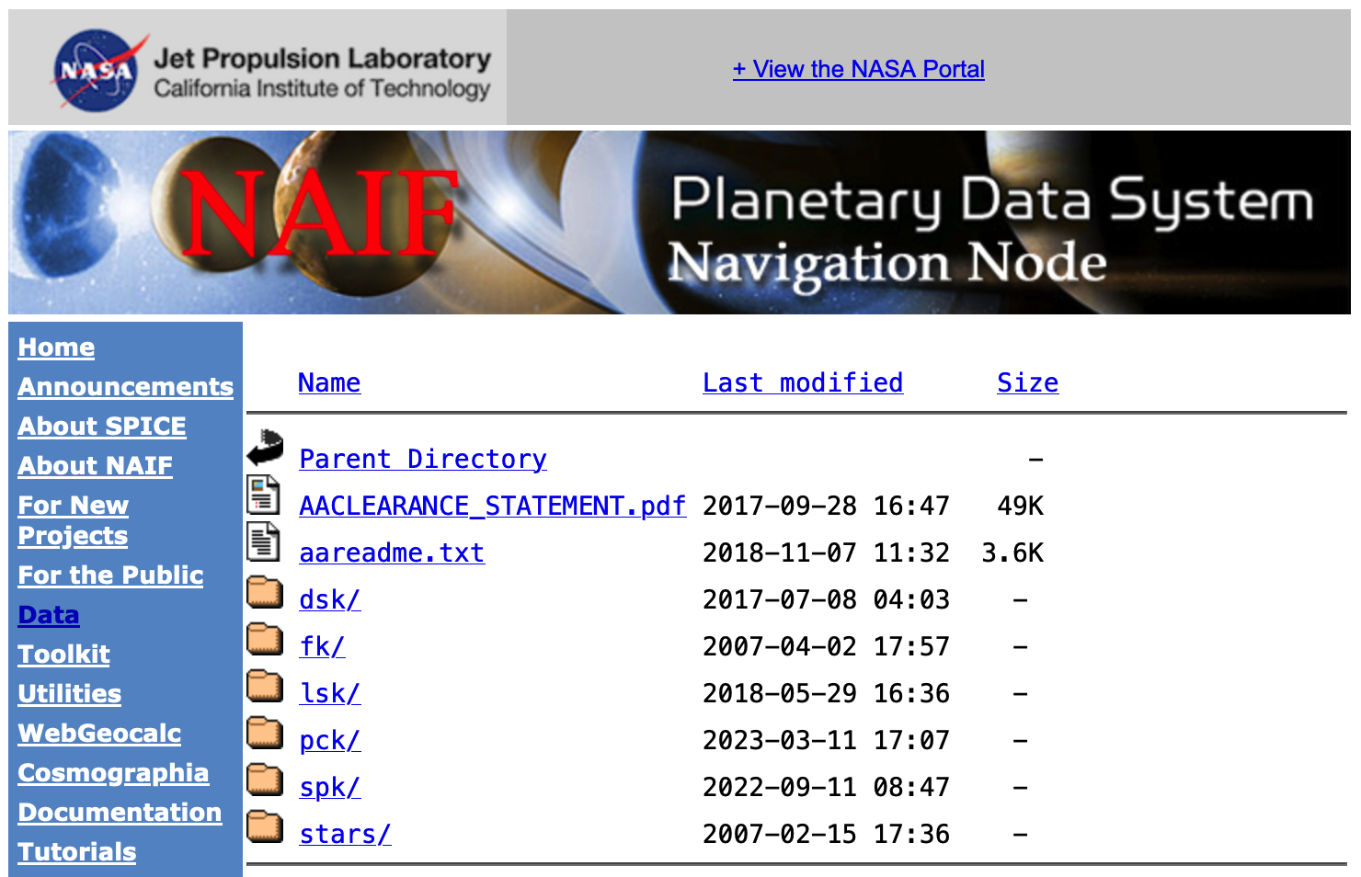
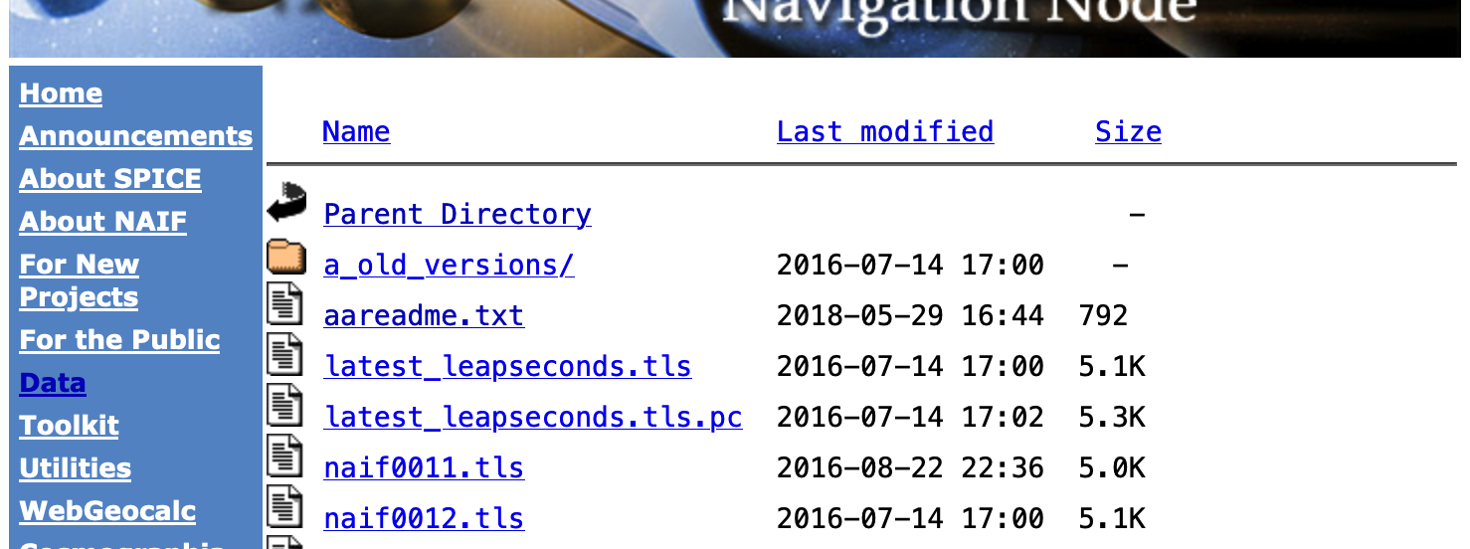
Getting Generic Kernels
1 – Select Data
2 – Select Generic Kernels
3 - Select Generic Kernels
4 – Select the kernel type
5 - Select Kernels of Interest
Description of folder contents and naming scheme
Latest LSK file

Slide 14
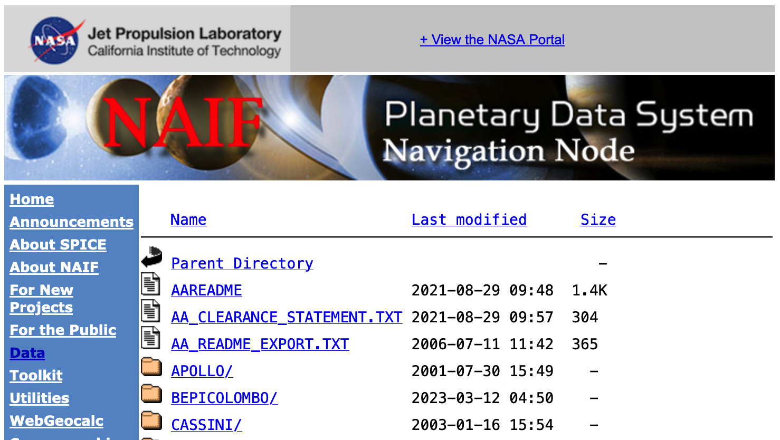
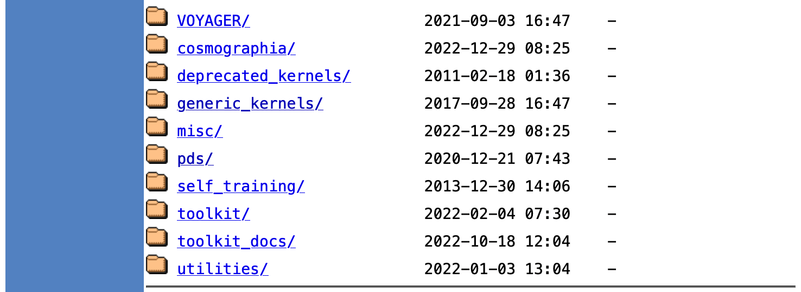
Direct Access to Server Directory Tree
Everything publicly available on the NAIF server is also accessible by browsing its directory tree starting at
https://naif.jpl.nasa.gov/pub/naif
Operational and past project kernel directories
. . .
Generic kernels
Cosmographia packages and additional materials
PDS archives and generic WebGeocalc kernel sets
Toolkit packages
Toolkit utilities
Toolkit documentation, Tutorials and Lessons

Slide 15
Horizons
The Horizons server is an on-line ephemeris generator for natural bodies (and more)
It is operated by JPL’s Solar System Dynamics Group, not by NAIF
Of primary interest to SPICE users is its ability to generate up-to-date SPK files for comets and asteroids
Horizons home page:
https://ssd.jpl.nasa.gov/horizons/
Horizons web interface for manual generation of small body SPKs:
https://ssd.jpl.nasa.gov/horizons/app.html#/
Horizons telnet interface for automated (programmatic) generation of small body SPKs:
telnet ssd.jpl.nasa.gov 6775
For an example script, use anonymous ftp to go to:
ssd.jpl.nasa.gov
and once there, look at pub/ssd/SCRIPTS/smb_spk

