Slide 1
Fundamental Concepts
April 2023

Slide 2
Topics
Preface
Time
Reference Frames
Coordinate Systems
Positions and States
Aberration Corrections

Slide 3
Preface
This tutorial introduces terminology and concepts used in the later SPICE tutorials.
Some of this material is more difficult than what follows in later presentations.
A complete understanding of this material is not essential in order to use SPICE.
Still, we think this information may be helpful, so… on we go!

Slide 4
Time
An epoch is an instant in time specified by some singular event
Passage of a star across your zenith meridian
Eclipse of a spacecraft signal as it passes behind a solid body
Clocks
Clocks count epochs specified by events such as: “regular” oscillations of a pendulum, quartz crystal, or electromagnetic radiation from a specified source, measured from an agreed upon reference epoch.
Careful specification of epochs using clocks requires reference to the particular clock and the location of that clock.
Time Systems
Are agreed upon standards for “naming” epochs, measuring time, and synchronizing clocks

Slide 5
Atomic Time and UTC
International Atomic Time (TAI)
Statistical time scale
Based on data from ~200 atomic clocks in over 50 national laboratories
Maintained by Bureau International des Poids et Mesures (BIPM)
Unit is the SI (System International) second
duration of 9192631770 periods of the radiation corresponding to the transition between two hyperfine levels of the ground state of the cesium 133 atom
TAI is expressed as a count of atomic seconds past the astronomically determined instant of midnight 1 Jan 1958 00:00:00
Coordinated Universal Time (UTC)
Civil Time at Greenwich England (~GMT)
Usual Calendar Formats plus Hour:Minute:Second.fraction
Relationship between TAI and UTC
UTC + 10 seconds + number of leap seconds = TAI
Valid only after Jan 01, 1972

Slide 6
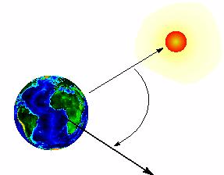
Astronomical Time – UT1
Astronomical Time (UT1) is an hour representation of the angle between the Greenwich zenith meridian and the location of the “computed mean sun.”
Used prior to atomic time for civil time keeping
UT1

Slide 7
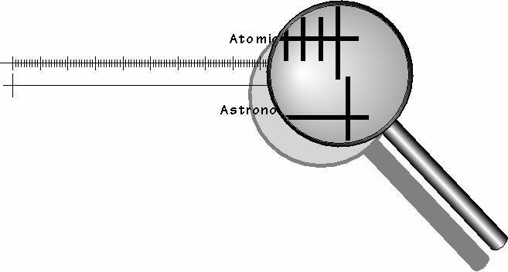
Tying UTC to Earth’s Rotation (UT1)
Ideally, UTC noon and astronomical noon at Greenwich (UT1) should occur simultaneously. However, the earth’s rotation is not uniform. Eventually, UTC noon and astronomical noon at Greenwich get out of sync.
UTC
UT1
When the mismatch becomes greater than 0.9 atomic seconds, a “leap second” is added to (or removed from) the end of a designated UTC day—normally either June 30 or December 31.
The variations in the earth’s rotation that cause leap seconds to be needed are not predictable.

Slide 8
Leapseconds (+ and -)
“Normal” sequence of UTC time tags
1998 Dec 31 23:59:58.0
1998 Dec 31 23:59:59.0
1999 Jan 01 00:00:00.0
1999 Jan 01 00:00:01.0
Sequence with a Positive Leapsecond
1998 Dec 31 23:59:58.0
1998 Dec 31 23:59:59.0
1998 Dec 31 23:59:60.0
1999 Jan 01 00:00:00.0
1999 Jan 01 00:00:01.0
Sequence with a Negative Leapsecond
1998 Dec 31 23:59:57.0
1998 Dec 31 23:59:58.0
1999 Jan 01 00:00:00.0
1999 Jan 01 00:00:01.0
Leap seconds complicate the task of
finding the duration between two
UTC epochs:
You need to know when past leap seconds occurred to compute durations defined by pairs of past UTC epochs.
Durations defined by pairs of future UTC epochs are indeterminate if leap seconds could occur in the interim.

Slide 9
Barycentric Dynamical Time
Barycentric Dynamical Time (TDB) and Ephemeris Time (ET) are synonyms in SPICE documentation.
TDB is
a mathematical ideal used in the equations of motion.
used as the independent time variable for many SPICE subroutine interfaces.
related to Barycentric Coordinate Time (TCB) by an offset and a scale factor.
TDB advances on average at very close to the same rate as TAI---the difference is nearly periodic.

Slide 10
Terrestrial Dynamical Time
Terrestrial Dynamical Time (TDT)
TDT is the Ideal Time (proper time) on Earth at sea level
TDT = TAI + 32.184 seconds
The IAU has adopted the name “Terrestrial Time” (TT)
But this is called TDT throughout SPICE documentation
TDB and TDT have nearly the same reference epoch (approximately 1 Jan 2000, 12:00:00 at Greenwich England), called “J2000.”
TDB and TDT advance at different rates.
Variations are small: ~ 1.6 milliseconds
Variations are almost periodic with a period of 1 sidereal year (to first order)
Variations are due to relativistic effects
TDB = TDT + 0.001657 sin( E + 0.01671sin(E) )
Use of TDT in the SPICE system is quite limited.
SCLK kernels
Duration computations involving UTC

Slide 11
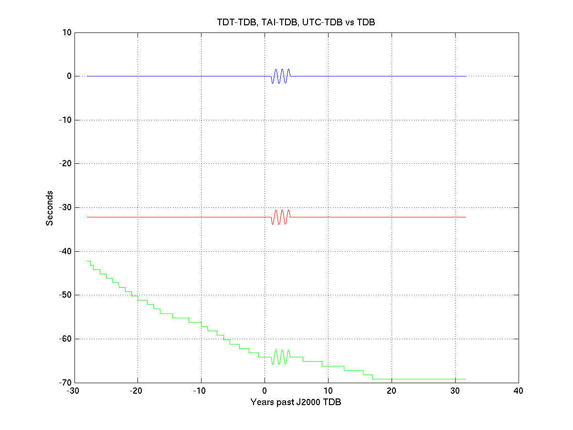
Offsets between Time Systems
Difference between seconds past J2000 in a given time system and TDB seconds past J2000 TDB. Systems used for comparison are TDT, TAI, and UTC:
TDT-TDB
Magnified by 1000
As magnified amplitude views show, slopes are actually non-zero and non-constant: clocks in different time systems generally run at slightly different rates, and the differences in rates may be time-varying.
TAI-TDB
Actual amplitude of
periodic term =
~1.6e-3 seconds
Magnified by 1000
Differences at TDB = J2000 are non-zero: the epoch “J2000” = 2000 JAN 1 12:00:00 in different time systems occurs at different TDB times.
UTC-TDB
Magnified by 1000

Slide 12
Spacecraft Clocks
Spacecraft have onboard clocks to control scheduling of observations, maneuvers, attitude adjustments, etc.
Used to time stamp data
Fundamental unit of time is the “tick”
Smallest increment possible for a spacecraft clock
Nominal tick duration is spacecraft clock dependent
Spacecraft clock time is a count of ticks since some reference tick.
The duration of the tick drifts with respect to other time systems because spacecraft clocks are not very stable

Slide 13
More about Spacecraft Clocks
SCLK string formats vary from one spacecraft clock to the next.
Cassini: Maximum reading for partition 1 = 1/4294967295.255
Partition number: 1
Seconds: 4294967295
Ticks (for Cassini, unit = 1/256 second): 255
Galileo: Maximum reading for partition 1 = 1/16777215:90:09:07
Partition number: 1
"RIM" count (unit = 60 2/3 seconds): 16777215
"Mod 91" count (unit = 2/3 second): 90
"RTI" count (unit = 1/15 second): 9
"Mod 8" count (unit = 1/120 second): 7
The format of spacecraft clock and the relationship between tick count and other time systems (usually UTC) is captured in a SPICE SCLK kernel

Slide 14
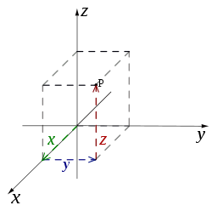
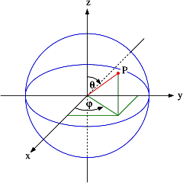
SPICE Definitions: Reference Frames & Coordinate Systems
A reference frame is an ordered set of three mutually orthogonal (possibly time dependent) unit-length direction vectors, coupled with a location called the frame’s “center” or “origin.”
SPICE documentation frequently uses the shorthand “frame” instead of “reference frame.”
The ordered set of axes of a reference frame is also called a “basis.”
A coordinate system specifies the method of locating a point within a reference frame.
Two examples of coordinate systems
Cartesian coordinates
Spherical coordinates

Slide 15
Reference Frame Center
A reference frame’s center is an ephemeris object whose location is coincident with the origin (0, 0, 0) of the frame.
The center of the IAU_<body> frame is center of mass of <body>.
The center of any inertial frame is (in SPICE) the solar system barycenter.
True even for frames naturally associated with accelerated bodies, such as MARSIAU.
A frame’s center plays little role in specification of states
Origin cancels out when doing vector arithmetic
Whether positions of objects A and B are specified relative to centers C1 or C2 makes no difference:
(A – C1) – ( B – C1 ) = ( A – C2 ) – ( B – C2 ) = A – B
But the center *is* used in computing light time to centers of non-inertial frames
When the aberration-corrected state of Titan as seen from the Cassini orbiter is computed in the body-fixed IAU_Titan frame, light time is computed from Titan’s center to the Cassini orbiter, and this light time is used to correct both the state and orientation of Titan.
(Light time and aberration corrections are discussed later on.)

Slide 16
Types of Reference Frames
Inertial
Non-rotating
With respect to fixed stars
Non-accelerating origin
Velocity is typically non-zero; acceleration is negligible
Examples:
J2000 (also called ICRF), B1950
Non-Inertial
Examples
Body-fixed
Centered at body center
Topocentric
Instrument
Dynamic frames
For example, frames defined by time-dependent vectors

Slide 17
J2000 Frame
The J2000* (aka EME2000) frame definition is based on the earth’s equator and equinox, determined from observations of planetary motions, plus other data.
Z_{J2000}
Z is normal to the mean equator of date at epoch J2000 TDB, which is approximately Earth’s spin axis orientation at that epoch. (J2000 TDB is
2000 JAN 01 12:00:00 TDB, or JD 2451545.0 TDB).
Equatorial plane
Plane normal to the earth’s spin axis, Z
Ecliptic plane
Plane defined by movement of the earth around the sun
~23.4 deg
Y_{J2000}
Y = Z cross X
X_{J2000}
Intersection of
equatorial and
ecliptic planes,
called vernal
equinox
*Caution: The name “J2000” is also used to refer to the zero epoch of the ephemeris time system (ET, also known as TDB).

Slide 18
The ICRF Frame
The ICRF* frame is defined by the adopted locations of 295 extragalactic radio sources
Z
Solar System Barycenter
Y
X
*ICRF = International Celestial Reference Frame
The ICRF is managed by the International Earth Rotation Service (IERS)

Slide 19
J2000 vs. ICRF
The realization of ICRF was made to coincide almost exactly with the J2000 frame.
The difference is very small–a rotation of less than 0.1 arc second
These two frame names are treated synonymously in SPICE
In reality, any SPICE data said to be referenced to the J2000 frame are actually referenced to the ICRF frame
For historical and backwards compatibility reasons, only the name “J2000” is recognized by SPICE software as a frame name–not “ICRF”
No transformation is required to convert SPICE state vectors or orientation data from the J2000 frame to the ICRF.
ICRF = International Celestial Reference Frame, defined by the IERS
IERS = International Earth Rotation Service

Slide 20
Body-fixed Frames
Body-fixed frames are tied to a named body and rotate with it
The most common names, those for planets, satellites, the sun, and a few asteroids and comets, are hard-coded in SPICE software
Frame name style is “IAU_body name”
Examples: IAU_MARS, IAU_SATURN
To see all such names, see:
Frames Required Reading document, or
Latest generic PCK file
The rotation state (the orientation and angular velocity at time 𝑻) is usually determined using a SPICE text PCK containing data published by the IAU
The earth and moon are special cases!
IAU_EARTH and IAU_MOON both exist but generally should NOT be used
See the SPICE tutorial named “lunar-earth_pck-fk” for the best frames to be used for those bodies
On very rare occasions a CK is used to provide a body’s rotation state
Z
•
•
•
Y
X
Body-fixed

Slide 21
Topocentric Frames
Topocentric frames are attached to a surface
Z-axis is parallel to the gravity gradient or orthogonal to reference spheroid
z points “up”
Position Vector
y points West
x points North
Azimuth (increases
in clockwise direction, measured
from +x axis)
Elevation (angle between
vector and x-y plane)
Orthogonal projection of position vector onto x-y plane
One example of a topocentric frame. There are other types of topocentric frames: for example, the z-axis could point down, the x-axis North, and the y-axis East.

Slide 22
Coordinate System Conventions - 1
Planetocentric coordinate systems
For planets and their satellites the +Z axis (+90 LAT) always points to the north side of the invariable plane (the plane whose normal vector is the angular momentum vector of the solar system)
Planetocentric longitude increases positively eastward
Planetocentric latitude increases positively northward
Dwarf planets*, asteroids and comets spin in the right hand sense about their “positive pole.”
What the IAU now calls the “positive pole” is still referred to as the “north pole” in SPICE documentation.
The “positive pole” may point above or below the invariable plane of the solar system (see above).
This revision by the IAU Working Group (2006) inverts what had been the direction of the north pole for Pluto, Charon and Ida.
Planetocentric routines are RECLAT/ LATREC, RADREC/RECRAD, DRDLAT/DLATDR
(also known as latitudinal)
Z
Y
X
*The dwarf planets are: Ceres, Eris, Haumea, Makemake, Pluto

Slide 23
Coordinate System Conventions - 2
Planetodetic coordinate systems
Planetodetic longitude is planetocentric longitude
increases positively eastward
Planetodetic latitude
Tied to a reference ellipsoid
For a point on a reference ellipsoid, the angle measured from the X-Y plane to the surface normal at the point of interest. For other points, equals latitude at the nearest point on the reference ellipsoid
Latitude increases positively in the +Z direction
+Z is defined the same as for planetocentric coordinates
Planetodetic routines are RECGEO/GEOREC, DRDGEO/DGEODR
Z
Y
X

Slide 24
Coordinate System Conventions - 3
Planetographic coordinate systems
For planet and satellite planetographic coordinate systems:
Planetographic latitude is planetodetic latitude
Planetographic longitude is usually defined such that the sub-observer longitude increases with time as seen by a distant, fixed observer in an inertial reference frame
The earth, moon and sun are exceptions; planetographic longitude is positive east by default
Planetographic routines are PGRREC/RECPGR
For dwarf planets, asteroids and comets:
There are multiple, inconsistent standards! (USNO, IAU, PDS)
NAIF strongly suggests you use only planetocentric or planetodetic coordinates
Planetocentric routines are RECLAT/ LATREC, RADREC/RECRAD, DRDLAT/DLATDR
Planetodetic routines are RECGEO/GEOREC, DRDGEO/DGEODR
Z
.
Spin
direction
Y
X
Distant Observer

Slide 25
State Vectors
The state of an object is its position and velocity relative to a second object
In SPICE, these objects are often referred to as “target” and “observer” or “center”
E.g. Saturn relative to Saturn barycenter; Titan relative to Huygens probe
A state is always given in the TDB time system (also known as ET)
In the SPK subsystem a state is a six dimensional vector
First three components are Cartesian position: x, y, z
Second three components are Cartesian velocity: dx/dt, dy/dt, dz/dt
Units are km, km/sec
A state is specified relative to a reference frame

Slide 26
Transforming States
To perform algebraic operations on states they must be in the same reference frame.
Position-only frame transformations require only a rotation* matrix given as a function of time.
P_{B} (t) = R_{A to B}(t) P_{A}(t)
Position and velocity frame transformations require that we differentiate the above equation
dP_{B} (t) /dt = dR_{A to B}(t)/dt P_{A}(t) + R_{A to B}(t) d P_{A}(t)/dt
We can use a 6x6 matrix to combine these two transformations into a single equation
* Assuming both frames are right-handed

Slide 27
Transforming States
S_{B}(t) = T_{A to B}(t)S_{A}(t)
where
S_{i}(t) =
and
T_{A to B}(t) =
(
)
P_{i}(t)
dP_{i}(t)/dt i = A or B
(
R_{A to B}(t)
0
)
dR_{A to B}(t)/dt
R_{A to B}(t)
The SPICELIB routines SXFORM and PXFORM return state transformation and position transformation matrices respectively.

Slide 28
Aberration Corrections: Introduction
Within the SPICE system, “aberration corrections” are adjustments made to state vectors and time-dependent reference frames to accurately reflect the apparent–as opposed to the actual–state and attitude of a target object as seen from a specified observer at a specified time.
Actual, uncorrected states from an ephemeris are called “geometric” states.
When computing state vectors, SPICE users may request geometric or aberration-corrected states.
Aberration corrections are needed to accurately answer questions such as:
In which direction must a remote sensing instrument be pointed to observe a target of interest?
For a given pointing direction and observation time, what target body surface location would be observed by a remote sensing instrument?
In which direction must an antenna be pointed to transmit a signal to a specified target?

Slide 29
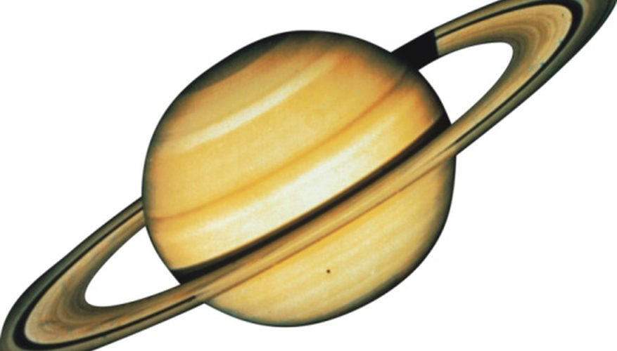
Computing Aberration-corrected States
In order to compute an aberration-corrected state, the state vectors used in the computation must all be chained back to the Solar System Barycenter
Saturn
+
Cassini spacecraft during interplanetary cruise
The aberration-corrected red vector cannot be computed unless all three green vectors are available.
Solar System Barycenter
+
Sun

Slide 30
Example: Predicted vs Actual Photo
We compare the predicted appearance of a photograph from an optical camera against the actual photograph. We show three predictions derived using different aberration corrections: NONE, LT ("light time only"), and LT+S ("light time plus stellar aberration").
For each prediction, we use red overlays to indicate the expected location in the photo of the images of an extended target body (for example, a natural satellite), of features on the surface of the target body, and of a star.
NONE
Predicted images using uncorrected target position and orientation and uncorrected star direction vector
LT
Predicted images using light time-corrected target position and orientation and uncorrected star direction vector
LT+S
Predicted images using light time and stellar aberration-corrected target position, light time-corrected target orientation, and stellar aberration-corrected star direction vector

Slide 31
Prediction Without Corrections
Predicted target body, surface feature, and star image locations (in red). Actual locations are in blue and black.
Body motion relative to solar system barycenter
Actual star image
Actual body image
Using geometric target positions, target images in photos or other remote-sensing observations don’t appear at their predicted locations.

Slide 32
Light Time Corrections
Target’s velocity vector
Target’s angular velocity vector
Target’s (geometric) position and orientation at time ET
Target’s position and orientation at time ET-LT (light time corrected position and orientation)
Target travels this path (along the black arc) in LT seconds
Note: The angular separation of the geometric and light time corrected positions as seen by the observer has been exaggerated for readability.
Light travels this path in LT seconds
Observer’s position at time ET
At time ET, the observer’s camera records photons emitted from the target at time ET-LT, where LT is the one-way light time. The camera "sees" the target's position and orientation at ET-LT.

Slide 33
Prediction Using Light Time Corrections
Predicted target body, surface feature, and star image locations (in red). Actual locations are in blue and black.
Body motion relative to solar system barycenter
Actual star image
Actual body image
Using the light time corrected target position and orientation, the predicted locations in the photo of the target image and surface features have changed, but the accuracy of the prediction may still be poor.

Slide 34
Stellar Aberration Correction
Target’s position and orientation at time ET. This position is called the geometric or uncorrected position.
Target’s apparent position and orientation
Target’s position and orientation at time ET-LT (light time corrected position and orientation)
Note: The angular separation of the geometric, light time corrected, and apparent positions as seen by the observer has been exaggerated for readability.
Velocity component orthogonal to observer-target position
To the observer, light appears to travel this path
Observer’s velocity relative to Solar System Barycenter
Observer’s position at time ET
At time ET, the observer’s camera records photons emitted from the target at time ET-LT, where LT is the one-way light time.
The vector from the observer at ET to the location of the target at ET-LT is displaced by a physical phenomenon called stellar aberration. The displaced vector yields the apparent position of the target.

Slide 35
Prediction Using "LT+S" Corrections
Actual star image
Actual body image
Predicted target body, surface feature, and star image locations (in red)
Using the light time and stellar aberration-corrected target position, light time-corrected target orientation, and stellar aberration-corrected star direction, we obtain a significantly improved image location predictions.
Remaining prediction errors may be due to, among other causes, pointing error, spacecraft and target ephemeris errors, and timing errors.

Slide 36
Newtonian Stellar Aberration Effect
Camera
Photon emission from Target at ET - LT
Photon reception
at ET
Photon path length = c * LT
“V” = observer velocity component orthogonal to radiation path.
We ignore parallel velocity component because it has negligible effect on photon path geometry.
Observer path length = V*LT
Observer at ET-LT
Solar System Barycentric Reference Frame
Component of photon path orthogonal to V. Length ~= c * LT
Photon emission from Target at ET - LT
Apparent direction to target
Component of photon path parallel to V. Length ~= V*LT
-Observer velocity component orthogonal to radiation path
Camera
Photon path in observer frame
Photon reception
at ET
Stellar aberration angle dtheta
sin(dtheta) = v/c +O(v²/c²)
Observer Reference Frame

Slide 37
Effect of Aberration Corrections - 1
Angular offsets between corrected and uncorrected position vectors over the time span 2004 Jan 1–2005 Jan1
Mars as seen from MEX:
LT+S vs NONE: .0002 to .0008 degrees
LT vs NONE: .0006 to .0047 degrees
Earth as seen from MEX:
LT+S vs NONE: .0035 to .0106 degrees
LT vs NONE: .0000 to .0057 degrees
MEX as seen from Earth:
LT+S vs NONE: .0035 to .0104 degrees
LT vs NONE: .0033 to .0048 degrees
Sun as seen from Mars:
LT+S vs NONE: .0042 to .0047 degrees
LT vs NONE: .0000 to .0000 degrees

Slide 38
Effect of Aberration Corrections - 2
Angular offsets between corrected and uncorrected position vectors over the time span 2004 Jan 1–2008 Jan1
Saturn as seen from CASSINI:
LT+S vs NONE: .0000 to .0058 degrees
LT vs NONE: .0001 to .0019 degrees
Titan as seen from CASSINI:
LT+S vs NONE: .0000 to .0057 degrees
LT vs NONE: .0000 to .0030 degrees
Earth as seen from CASSINI:
LT+S vs NONE: .0000 to .0107 degrees
LT vs NONE: .0000 to .0058 degrees
CASSINI as seen from Earth:
LT+S vs NONE: .0000 to .0107 degrees
LT vs NONE: .0000 to .0059 degrees
Sun as seen from CASSINI:
LT+S vs NONE: .0000 to .0059 degrees
LT vs NONE: .0000 to .0000 degrees

Slide 39
Effect of Aberration Corrections - 3
Angular offsets between corrected and uncorrected position vectors over the time span 2025 Apr 1–2028 May 23
Earth as seen from Mercury:
LT+S vs NONE: .0001 to .0168 degrees
LT vs NONE: .0050 to .0058 degrees
Mercury as seen from Earth:
LT+S vs NONE: .0001 to .0168 degrees
LT vs NONE: .0000 to .0112 degrees
Mercury as seen from MPO:
LT+S vs NONE: .0004 to .0006 degrees
LT vs NONE: .0000 to .0113 degrees
MPO as seen from Earth:
LT+S vs NONE: .0000 to .0169 degrees
LT vs NONE: .0000 to .0113 degrees
Earth as seen from MPO:
LT+S vs NONE: .0000 to .0169 degrees
LT vs NONE: .0050 to .0058 degrees

Slide 40
Effect of Aberration Corrections - 4
Range differences between position vectors computed using LT+S vs CN+S corrections, over the time span 2025 Apr 1–2028 May 23
Earth as seen from Mercury:
LT+S vs CN+S: 0.0000 to 0.6760 km
Mercury as seen from Earth:
LT+S vs CN+S: 0.0000 to 5.6949 km
Mercury as seen from MPO:
LT+S vs CN+S: 0.0000 to 0.0001 km
MPO as seen from Earth:
LT+S vs CN+S: 0.0000 to 5.8694 km
Earth as seen from MPO:
LT+S vs CN+S: 0.0000 to 0.6760 km

